Slide 1

Monthly Meeting
14/06/2024

Slide 2
Agenda
Midterm Colloquium Presentation
LiDAR look-into
To-do
MOMI & Summer update

Slide 3
LIDAR-enhanced closed-loop Active Wake Mixing Control
14/06/2024

Slide 4
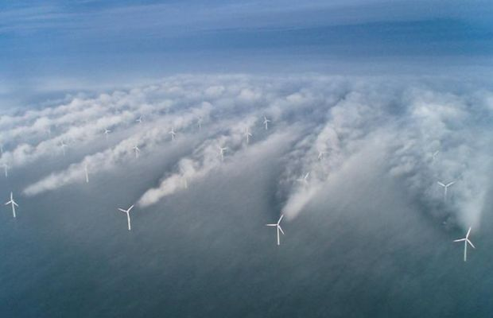
Wake Effect
Effect on downstream WT:
Less power production
Increase structural loads
20 – 45% Loss of Energy
Notes:
The downstream turbine encounters a significantly reduced free-stream velocity compared to the upstream turbine, leading to less energy being available in the flow.

Slide 5
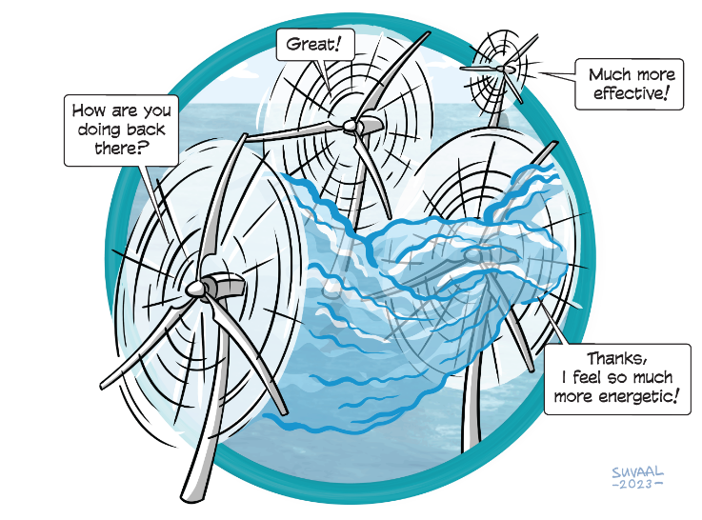
Wind Farm Flow Control
Axial Induction Control
Wake Steering
Wake Mixing

Slide 6
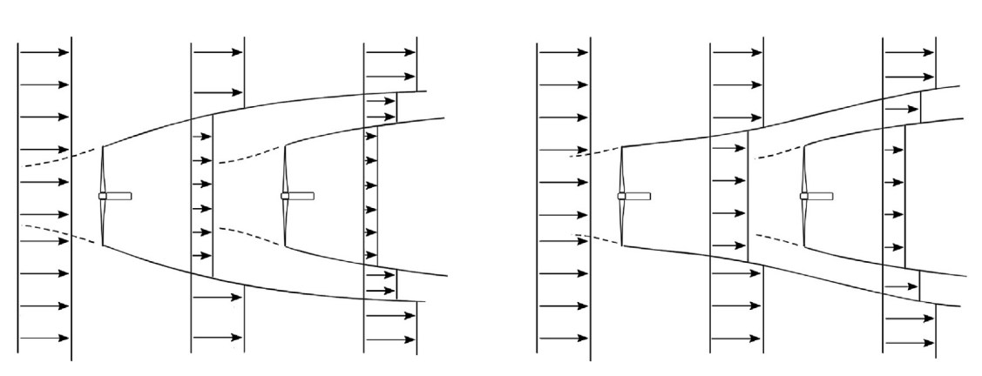
Axial Induction Control
Derate
the potential for increased energy extraction is rather low
Normal Operation
Axial Induction Control
Notes:
Delibrately operate the upstream turbine below the maximum condition to save more energy to the downstream turbine

Slide 7
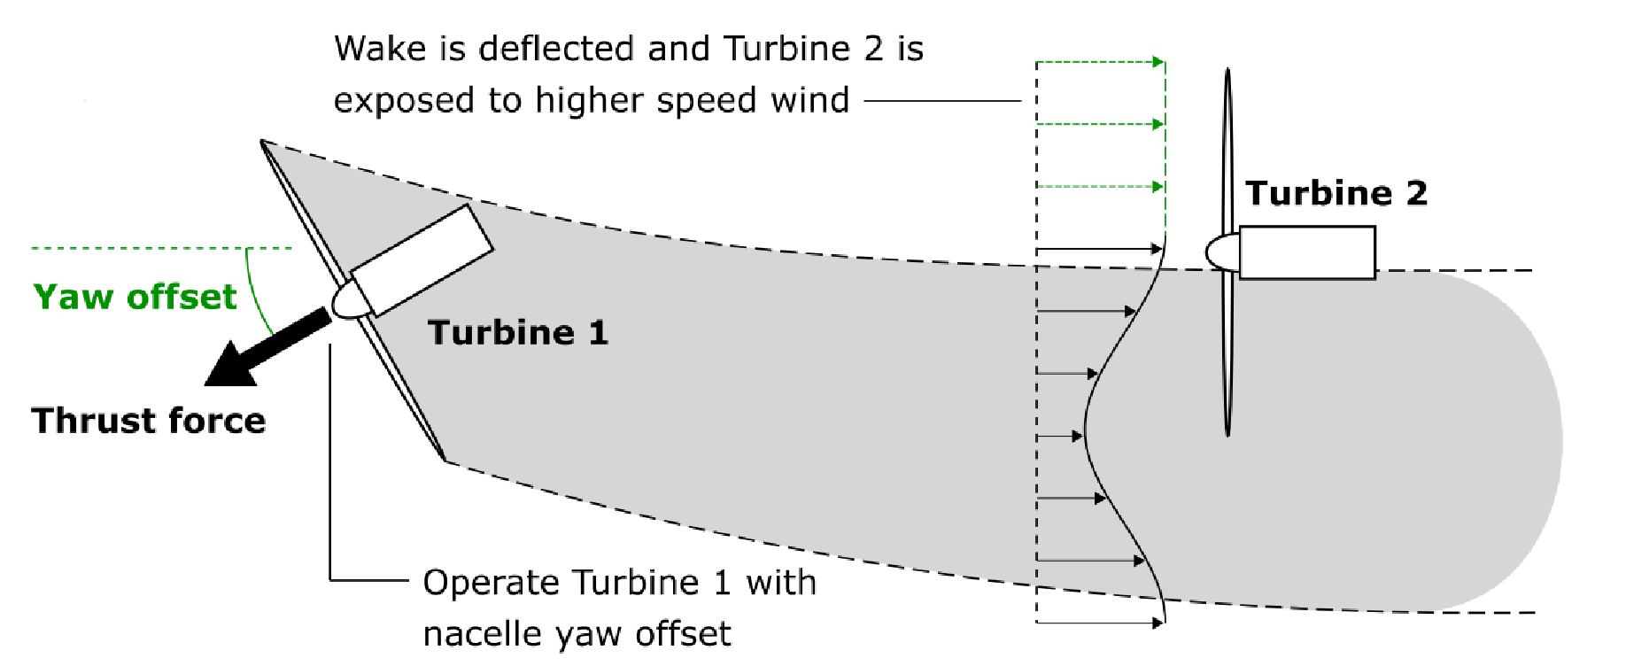
Wake Steering
Notes:
Decrease the overlap between the upstream turbine’s wake and the downstream turbine’s air by a yaw offset.
Advanced for commercial usage
Challenges remain in this area mostly related to the complex response of the wake to yaw set-points and its strong dependence on atmospheric conditions.

Slide 8
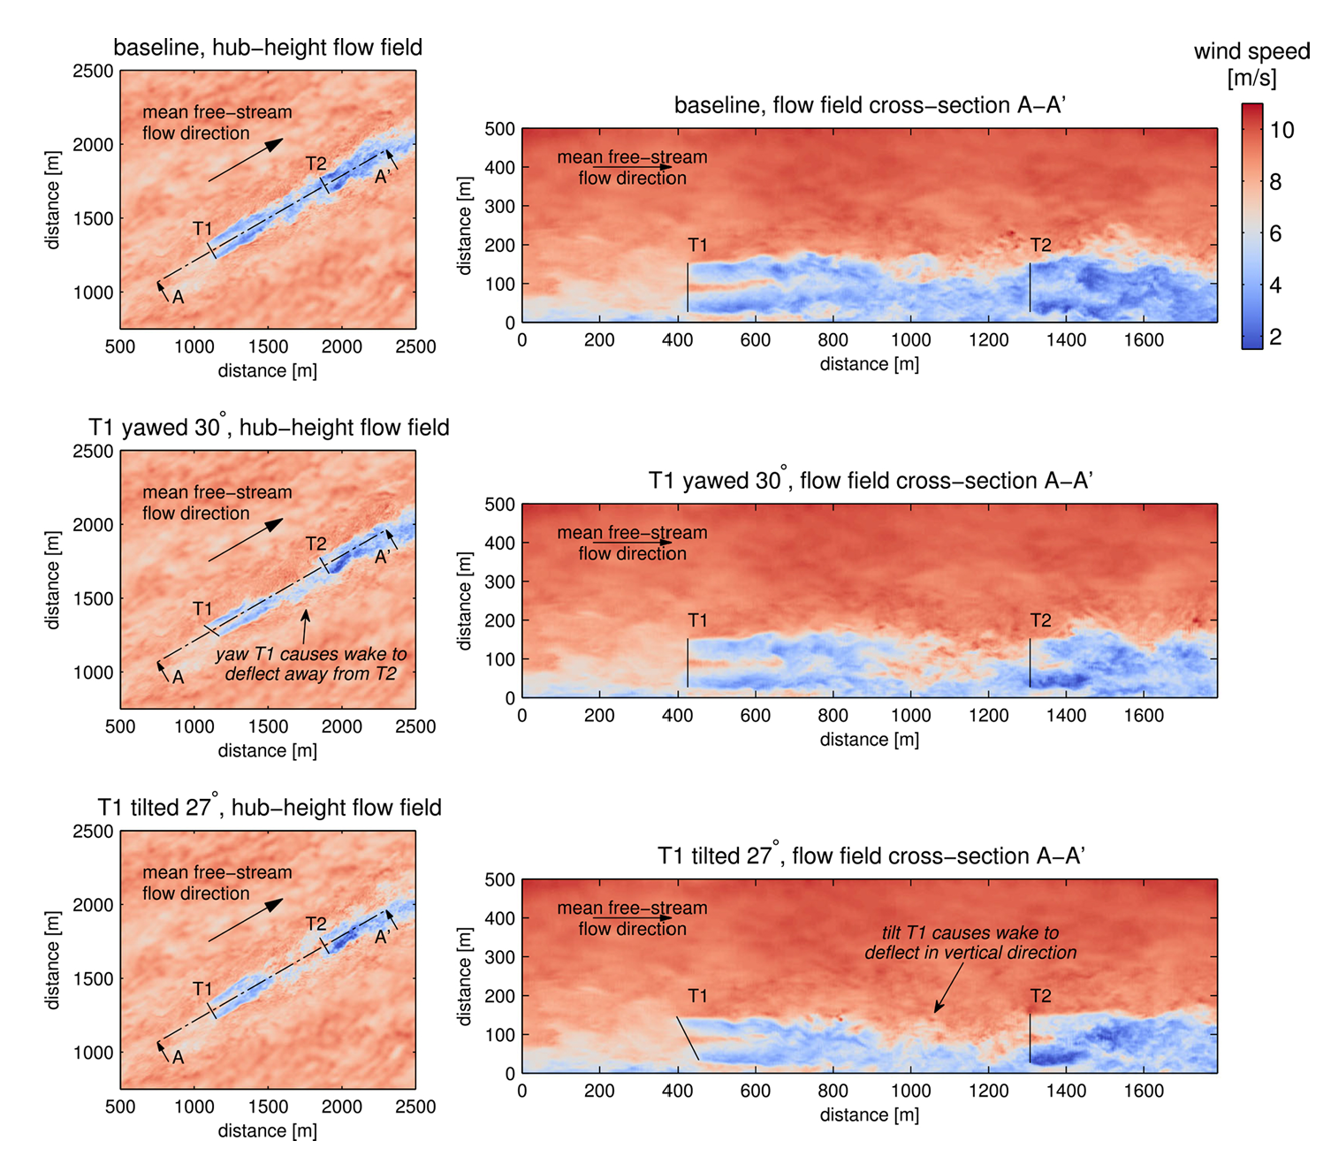
Notes:
Decrease the overlap between the upstream turbine’s wake and the downstream turbine’s air

Slide 9
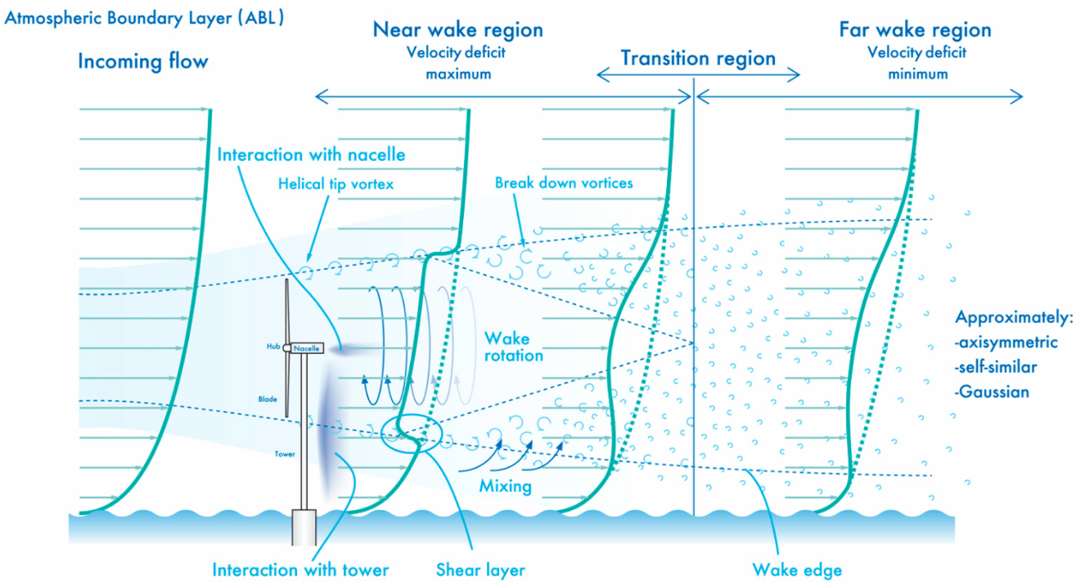
Wake Mixing
Notes:
This slide shows how the wake evolves with increasing distance from the turbine.
Wake recovers by mixing with the free-ambient air. Thus, if we can facilitate this mixing, there will be a faster recovery of wake, and thus, increase the power generation of the downstream turbine.
So let’s delve a bit deeper into how the wake is mixed.

Slide 10
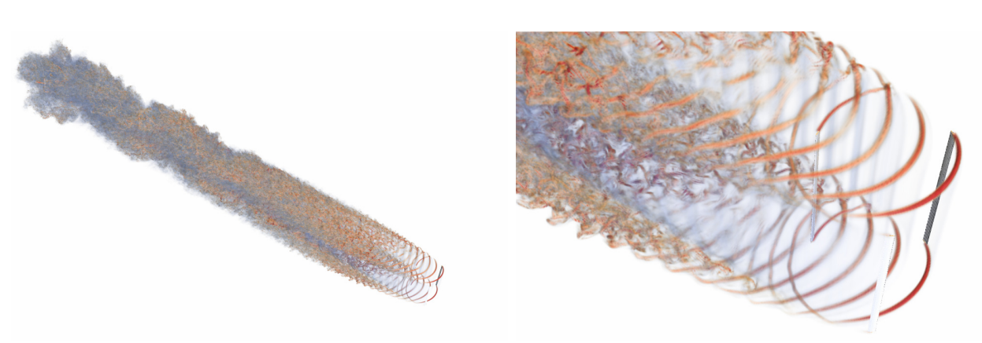
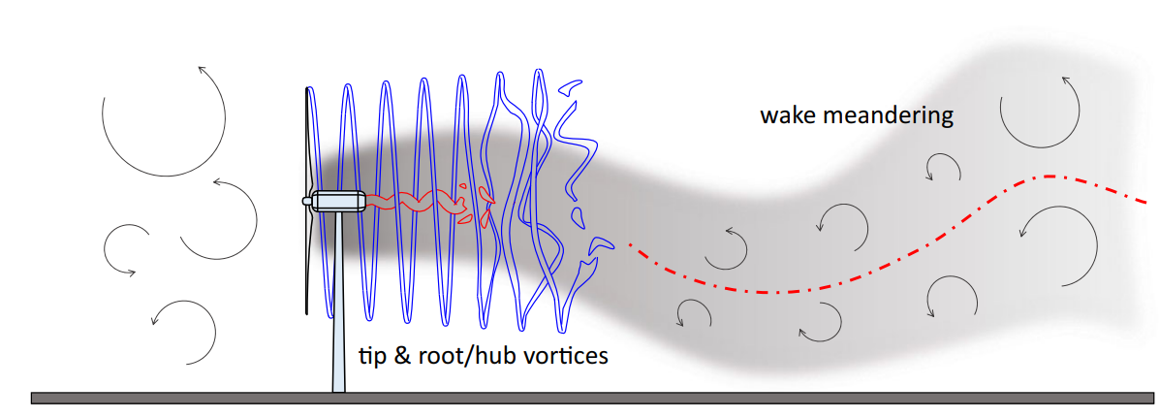
Wake Mixing
Notes:
Two mechanisms:
Tip & Root Vortex breakup
Wake Meandering
These two facilitate the mixing of wake with the ambient air. Hence, the wake mixing technique aims to facilitate those two things deliberately

Slide 11
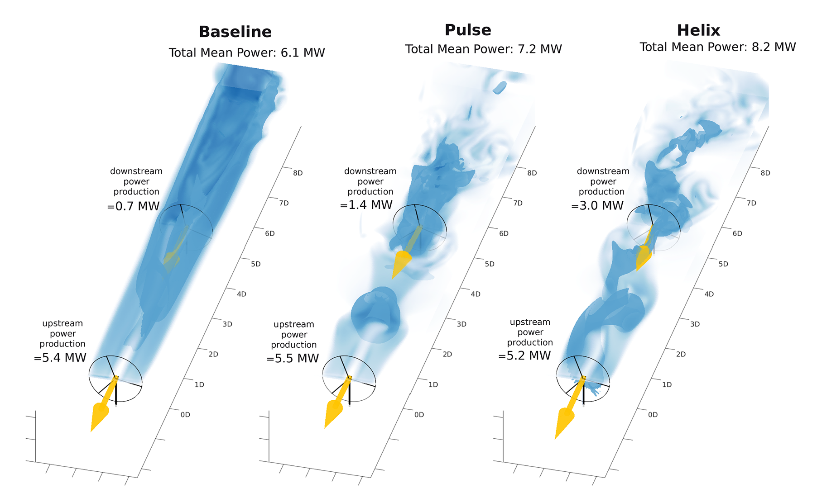
Wake Mixing
Facilitate mixing of free-ambient air and wake for wake recovery
Notes:
The wake mixing control strategy is developed to enhance the mixing of the turbine’s wake with ambient free-stream velocity air. This enhanced mixing accelerates the energy recovery of the wake more effectively than would occur through natural wake processes and recovery mechanisms.
Pulse: varying thrust coefficient sinusoidal ----> Load ----> More consistent
Helix: Individual Pitch Control

Slide 12
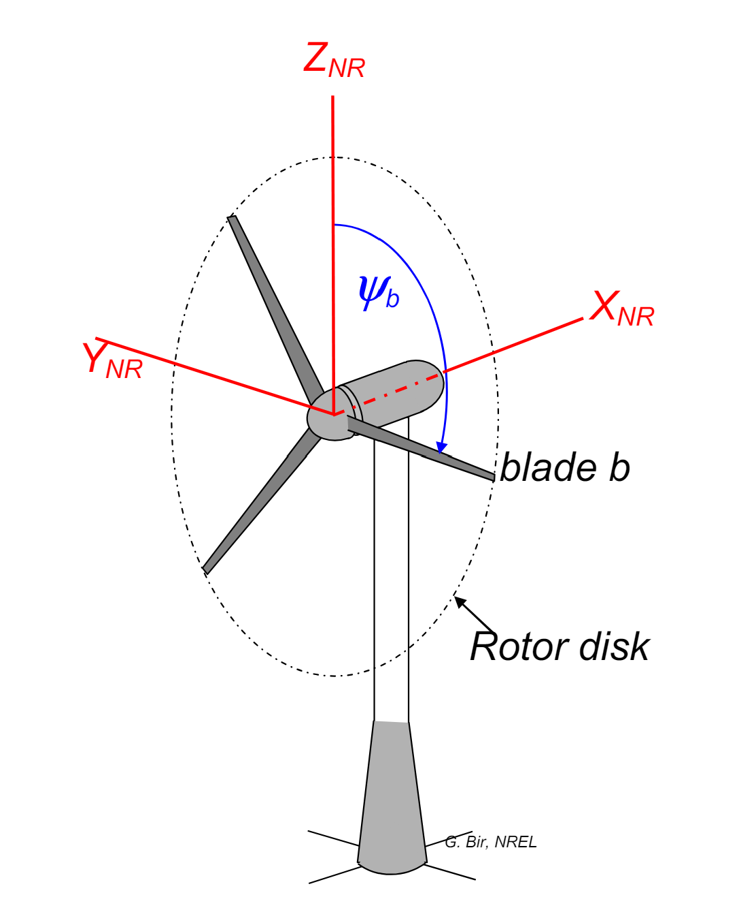
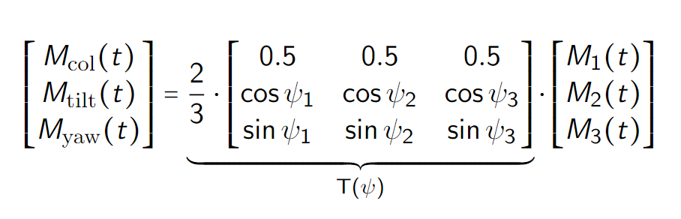
Helix --- MBC Transform
Rotating Frame → Non-rotating Frame
Notes:
MBC transform map the signals from rotating frame to the non-rotating one.

Slide 13
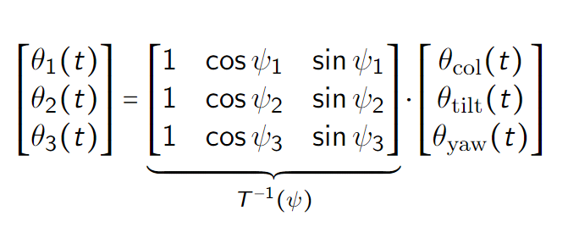
Helix --- Inverse MBC Transform
Non-rotating Frame → Rotating Frame
Notes:
By using the inverse MBC, we just need to give the tilt and yaw moment, then the blade pitch signals are acquired.

Slide 14
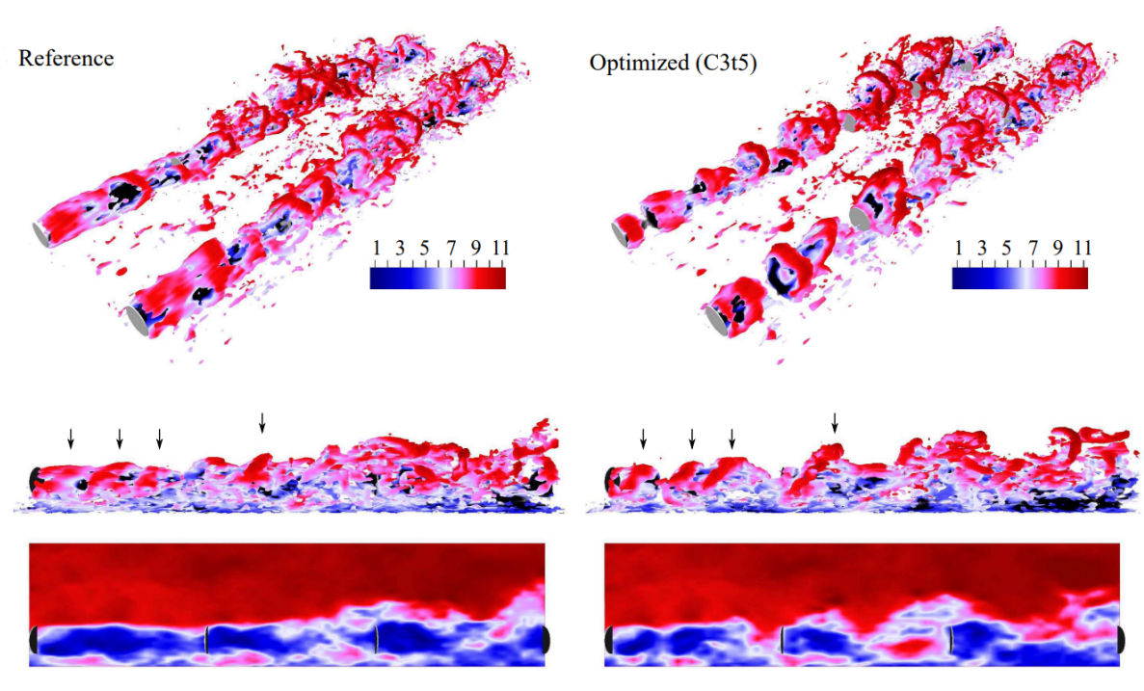
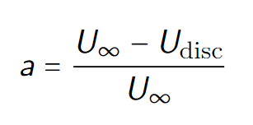
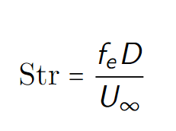
Helix --- Strouhal Number
Sinusoidal signals
Frequency
Amplitude
Empirical
Notes:
Now the problem is how to find the periodic signal of tilt and yaw? ---- periodic DIC
Go back to Pulse approach, the pulse is generated by manipulate the a. However, optimizing it can be very time-consuming real-time, thus a practical way should be using periodic DIC (induction factor definition), constrained to a sinusoidal signal. Thus, the control signal is now constrained to only frequency and amplitude. Subsequently, Strouhal number is defined to focus on the frequency, and amplitude is found empricially.

Slide 15
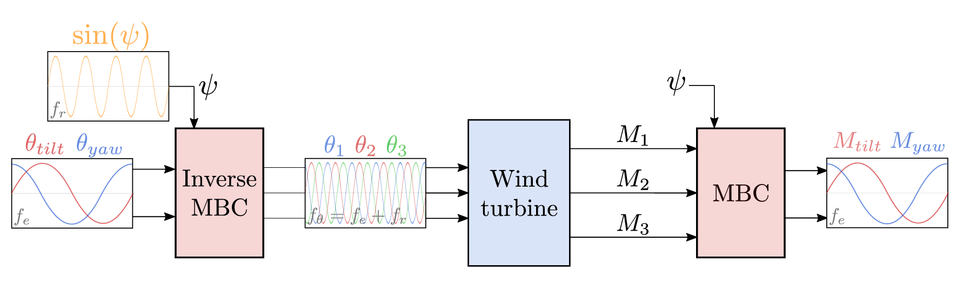
Helix --- Block Diagram
Notes:
Open-loop manner, we don’t know what is going on after the Helix is actuated.
Based on the phase different of tilt and yaw, clockwise and counterclockwise helix can be generated. Experiment results show that CCW is better in terms of wake mixing.

Slide 16
Gap of the Helix
Open-Loop Control:
Strongly depends on the accuracy of the model
Prone to disturbance
Lack of ability in handling uncertainties or model errors
Notes:
Open-loop: the performance strongly depends on the accuracy of the model and is prone to disturbances, shit in managing uncertainties and model errors.
For example, one of the turbine blade has some damages, with the OL control we ended up has a chaotic helix, the wake meandering effect seriously increase the load of the downstream.
Another example will be when the wind speed changes, since f_e is pre-determined, this would ended up in a helix that we don’t want, ending in slow recovery and load increase.

Slide 17
Research Question
How to closed-loop control the helix approach?
Handle model error, uncertainties
Real-time Control
Notes:
The main question, answer WHY you want to do all the stuff?

Slide 18
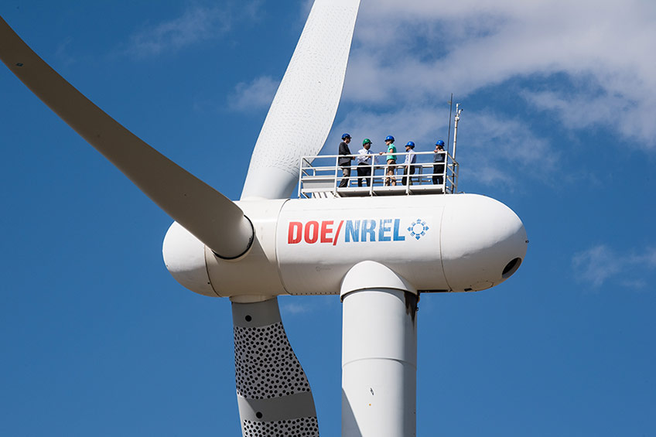
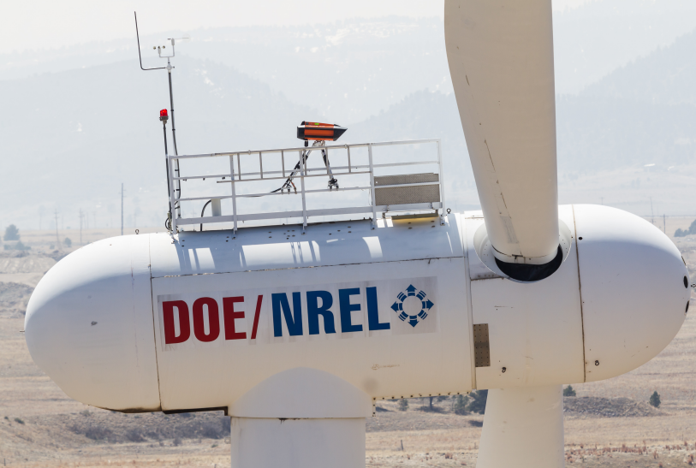
Feedback --- LiDAR
Notes:
To close the loop, one of the most important things is to get the feedback --- LiDAR

Slide 19
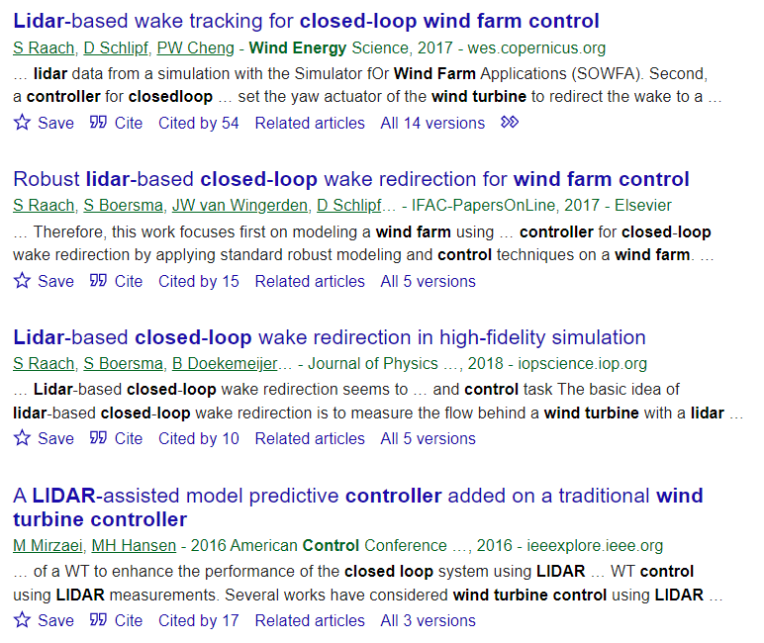
LiDAR CL Control

Slide 20
Research Question
How to use the LiDAR to construct a closed-loop control framework for the helix approach?
What LiDAR configuration?
Why Helix approach?
How to closed-loop control the helix?
What do you want to control?

Slide 21
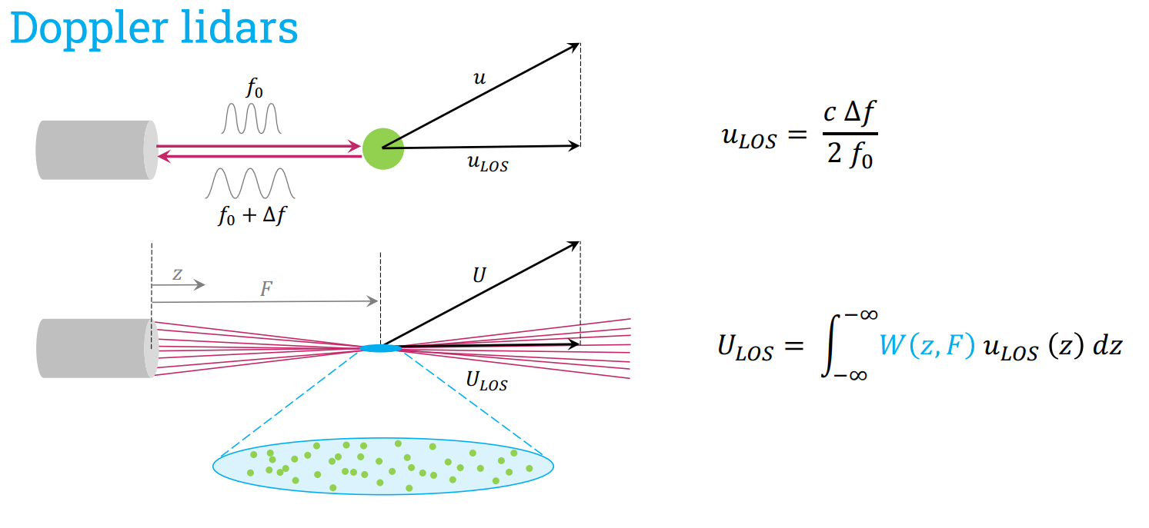

Slide 22
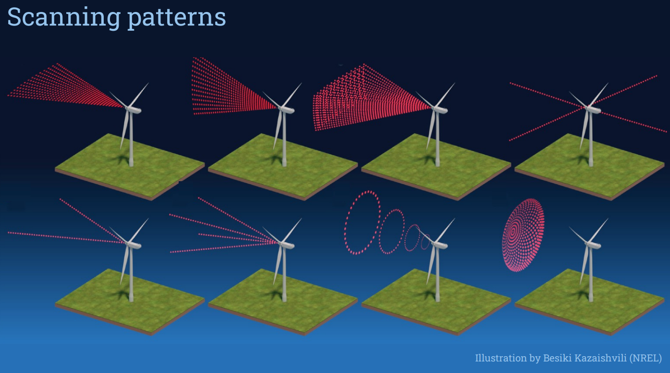

Slide 23
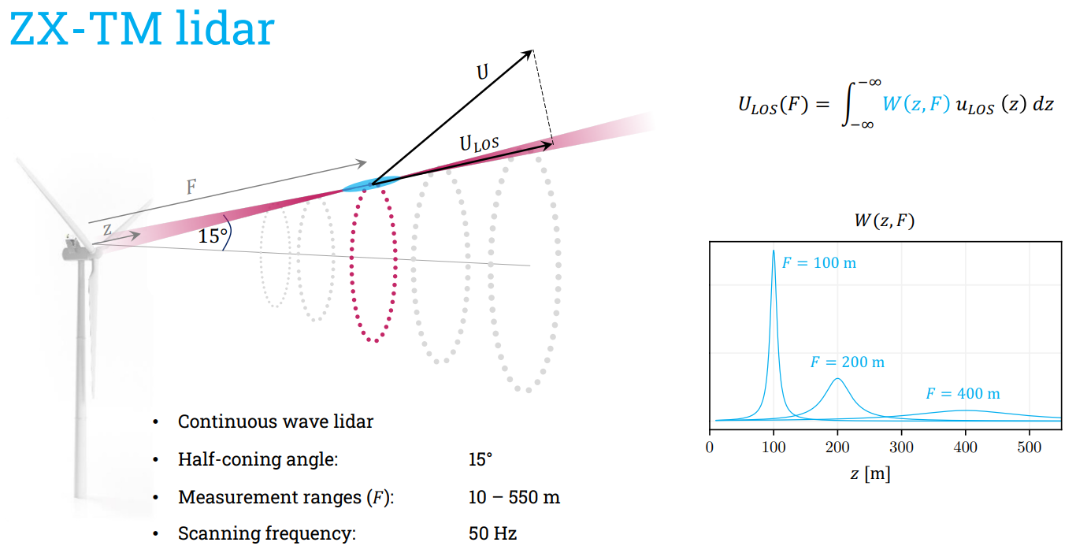

Slide 24
LiDAR Choosing
Trade off between practicality and quality --- Modified ZX-TM LiDAR
Continuous Wave LiDAR
10 – 720 m (3D IEA15MW)
Ring Measurement
Half-cone angle: -

Slide 25
Research Question
How to use the LiDAR to construct a closed-loop control framework for the helix approach?
What LiDAR configuration?
Why Helix approach?
How to closed-loop control the helix?
What do you want to control?
Notes:
So here, we answered the first question, what configuration of LiDAR to be used.

Slide 26
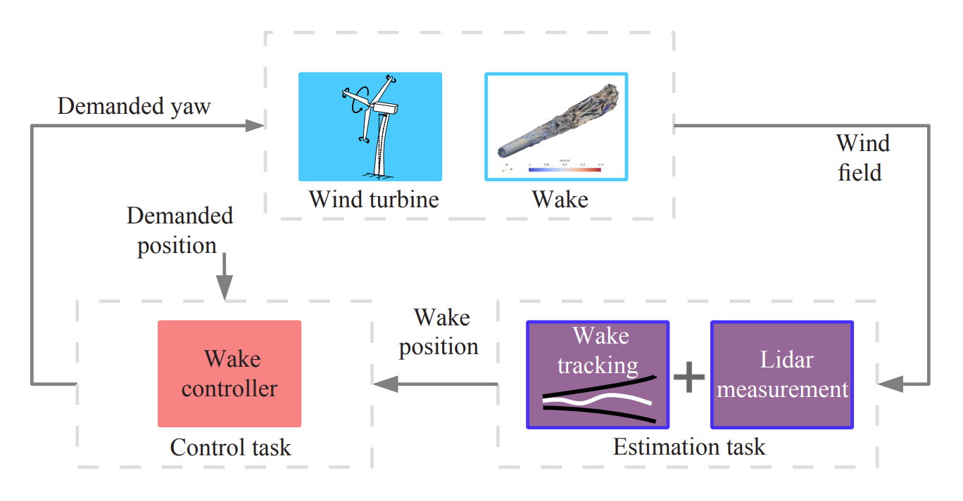
LiDAR CL Yaw Control

Slide 27
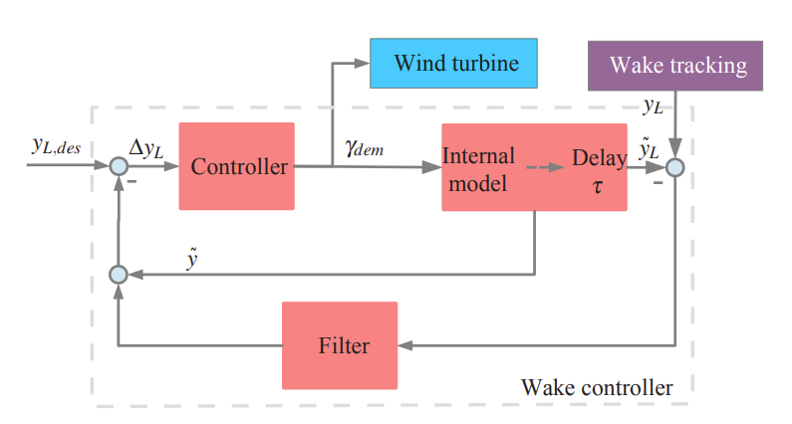
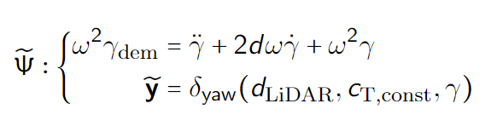
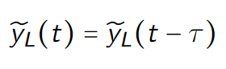
LiDAR CL Yaw Control
Notes:
Equations of internal model and delay.
The internal model predict the reaction of the wake to the demanded yaw angle. The first equation is the relationship of yaw, and then the second one is for the wake.

Slide 28
LiDAR CL Yaw Control

Slide 29
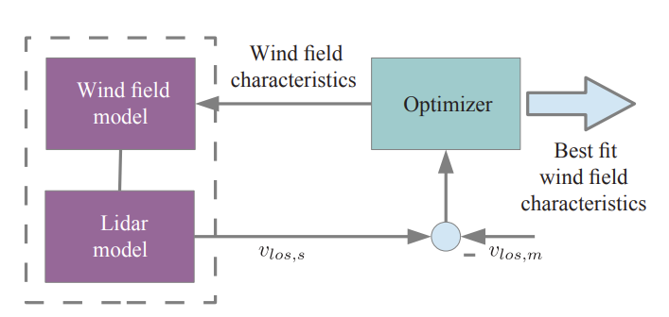
LiDAR CL Yaw Control
Notes:
Wind field reconstruction from LiDAR data: estimate wind field characteristics from an internal model by fitting simulated LiDAR data to the measured one. An optimizer is used to find the best fit for a model of the assumed wind field with the defined LiDAR configuration.
This mode is nonlinear

Slide 30
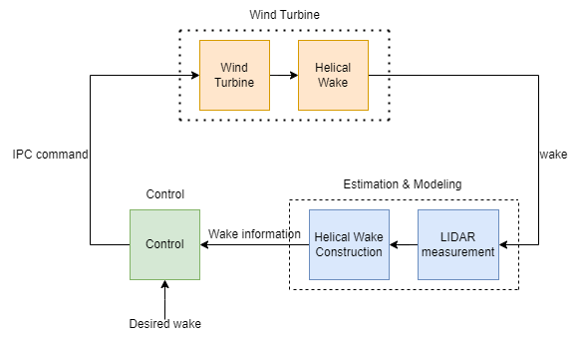
Proposed Framework

Slide 31
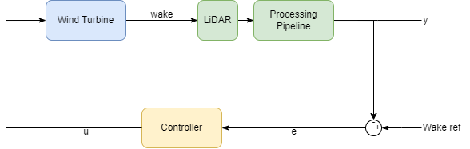
Proposed Framework

Slide 32
Proposed Framework
Prior Knowledge--- Periodic
Frequency
Phase
Notes:
This explain the reason why the helix approach is chosen as the object of study, because we have an very important prior knowledge

Slide 33
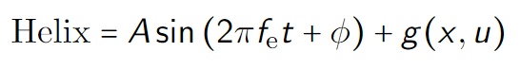
Estimation
Sine part represent first principle model, g(x,u) represents
the unknown dynamic.
Fix model ==> Real-time update model
Nonlinear Model
Notes:
Start simple with a fixed wind speed 8m/s and a fixed model. Then expands to real-time update model with changing windspeed.

Slide 34
Research Question
How to use the LiDAR to construct a closed-loop control framework for the helix approach?
What LiDAR configuration?
Why Helix approach?
How to closed-loop control the helix?
What do you want to control?
Controller design
Notes:
So here, we answered the first question, what configuration of LiDAR to be used.

Slide 35
Control Diagram
Feature of Helical Wake
a) Frequency
b) mean(u)
c) Brutal RT
Control Input
a) Amplitude of M-tilt/yaw (sensitivity study)
b) Str
Notes:
The goal of wake mixing is to facilitate the wake recovery by accelerating the mixing. From the previous introduction, the mixing is facilitate by wake meandering and tip/root- vortex breakup.
Moreover, the selected features should represent the wake recovery/mixing effect. Thus, frequency and u/u_average are chosen to represent the wake meandering and tip/root-vorterx.
As for control input, amplitude and frequency as chosen. But amplitude should be a bit more in front of frequency because of sensitivity study, as well as frequency doesn’t change much. But this might change when turbulence is added to the turbine.

Slide 36
Research Question
How to use the LiDAR to construct a closed-loop control framework for the helix approach?
What LiDAR configuration?
Why Helix approach?
How to closed-loop control the helix?
What do you want to control?
Controller design
Notes:
Features and control input are set. The next question is how to control?

Slide 37
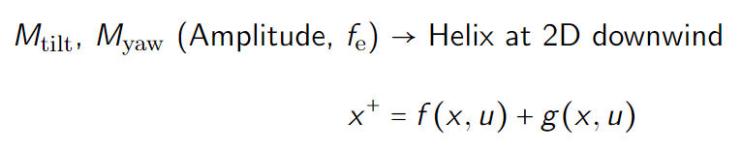
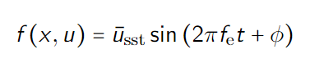
Data
Unknow dynamics because of turbulence etc.
To-be-learned
Notes:
Before designing the controller, let’s first look at what data do we have.
The dynamics can be split into a deterministic part f(x,u) and a un-deterministic part g(x,u). F(x,u) can be represented by a sine wave, while the g(x,u) should be learnt
Show this from figure

Slide 38
Data & Controller
Model-free: PI
Model-based: Learning-based MPC/DeePC
Load for blade because of the IPC
Control goal:
Brutally follow a perfect sine?
Something else?
Notes:
Start with PI, but end-goal is to use the learning-based MPC, or other data-driven control algorithm because I want to add constrains to the controller.
The goal of control should be explored a bit more, was it following a perfect sine wave? Or something else? But currently I would like to focus on following a perfect sine wave. As for conditions, it would be interesting to do two scenarios: 1. changing wind speed, 2. turbulence

Slide 39
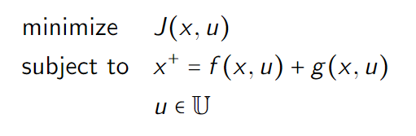
MPC Framework
Maximum WT power production
Ideal Helix properties
Learnt system dynamics under certain conditions
Input constrains to alleviate loads
Control goal:
Brutally follow a perfect sine?
Something else?

Slide 40
Research Question
How to use the LiDAR to construct a closed-loop control framework for the helix approach?
What LiDAR configuration?
Why Helix approach?
How to closed-loop control the helix?
What do you want to control?
Controller design

Slide 41
Thanks for listening :)

Slide 42
LiDAR Demo
14/06/2024

Slide 43
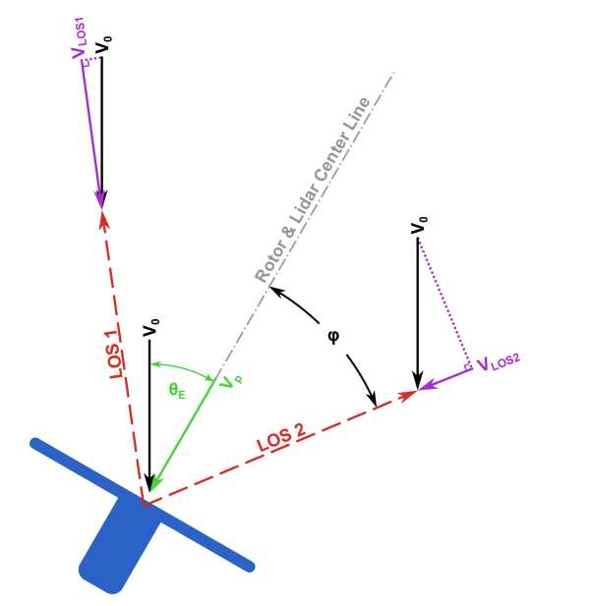
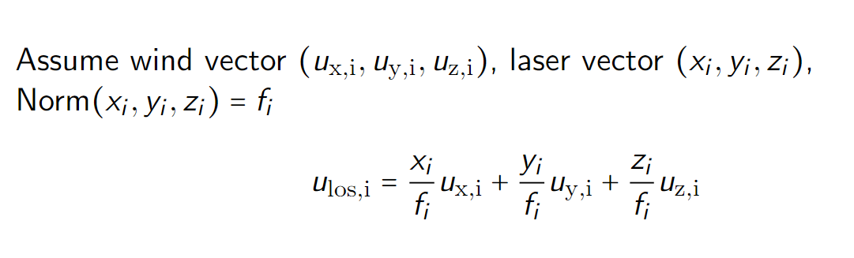
LiDAR Model
Notes:
LiDAR is placed in the perfect location --- 1.86D for IEA15MW so that the diameter of the ring is the same as D

Slide 44
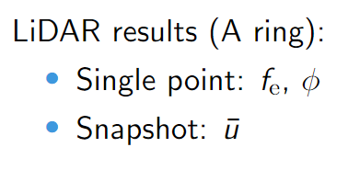
LiDAR Result
Notes:
Ring (periodic component)
Single Point (time domain, frequency domain)
Average (time domain, frequency domain)

Slide 45
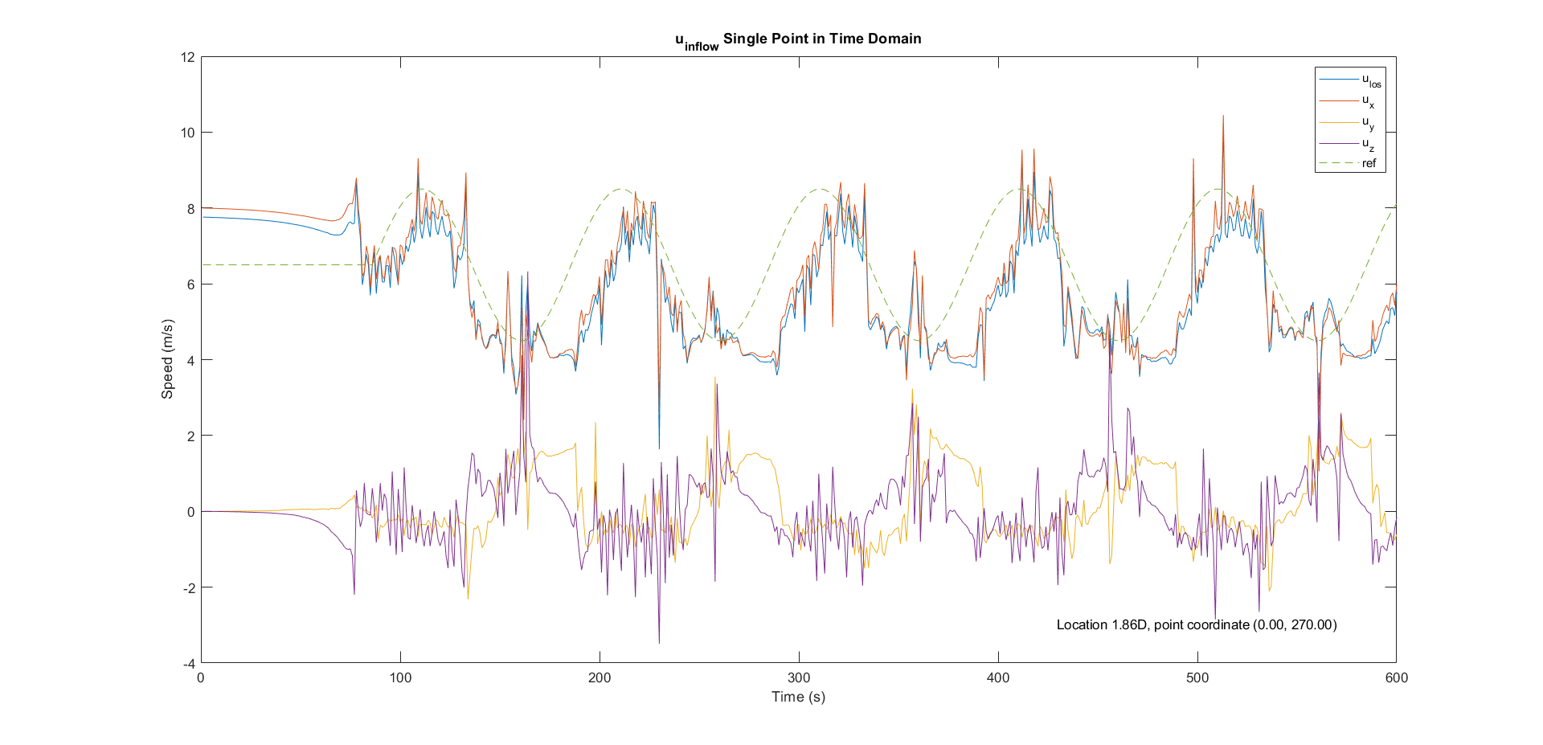
LiDAR --- single point (8m/s)

Slide 46
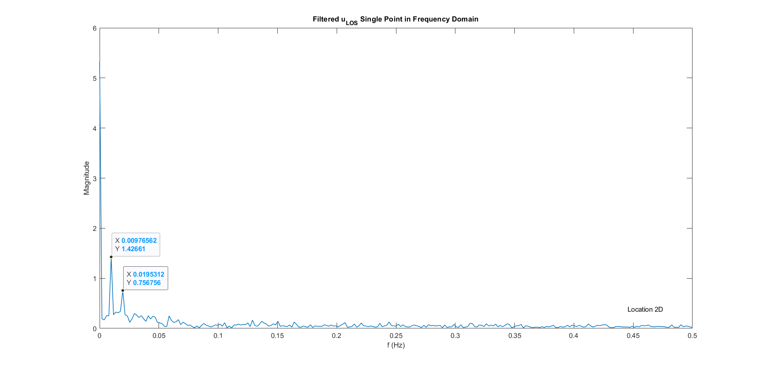
LiDAR --- single point FFT (8m/s)
Notes:
0.01

Slide 47
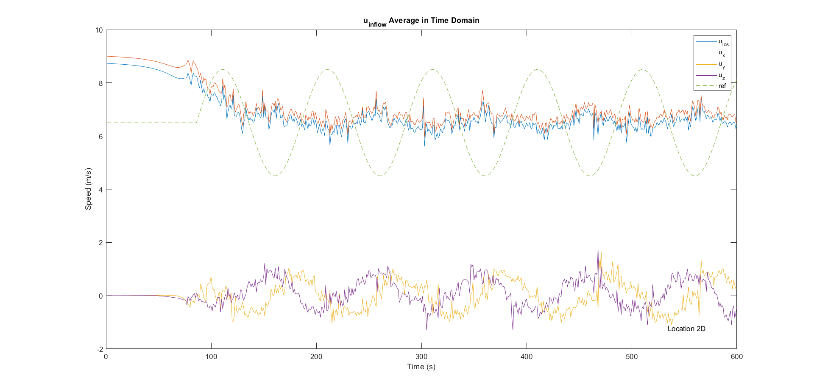
LiDAR --- snapshot (8m/s)

Slide 48
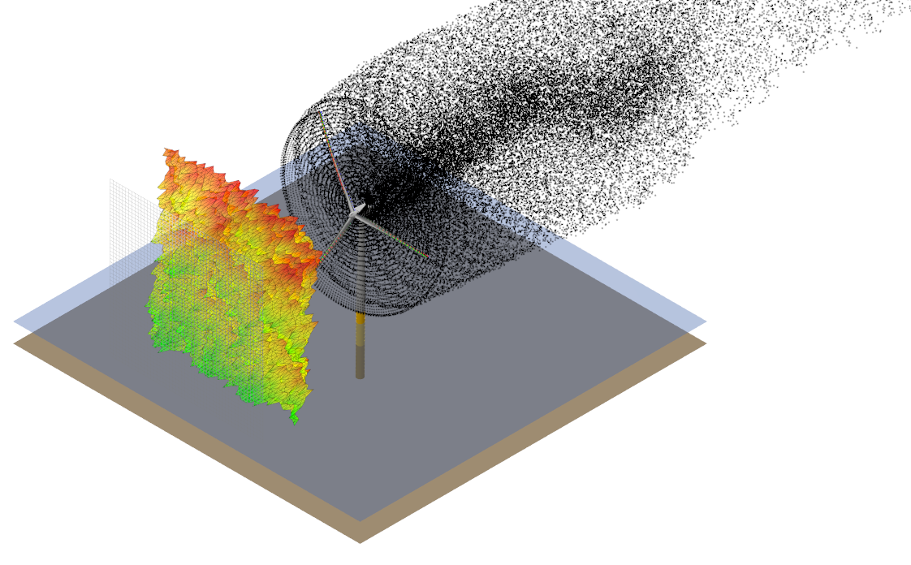
LiDAR --- Turbulence NTM-C (8m/s)

Slide 49
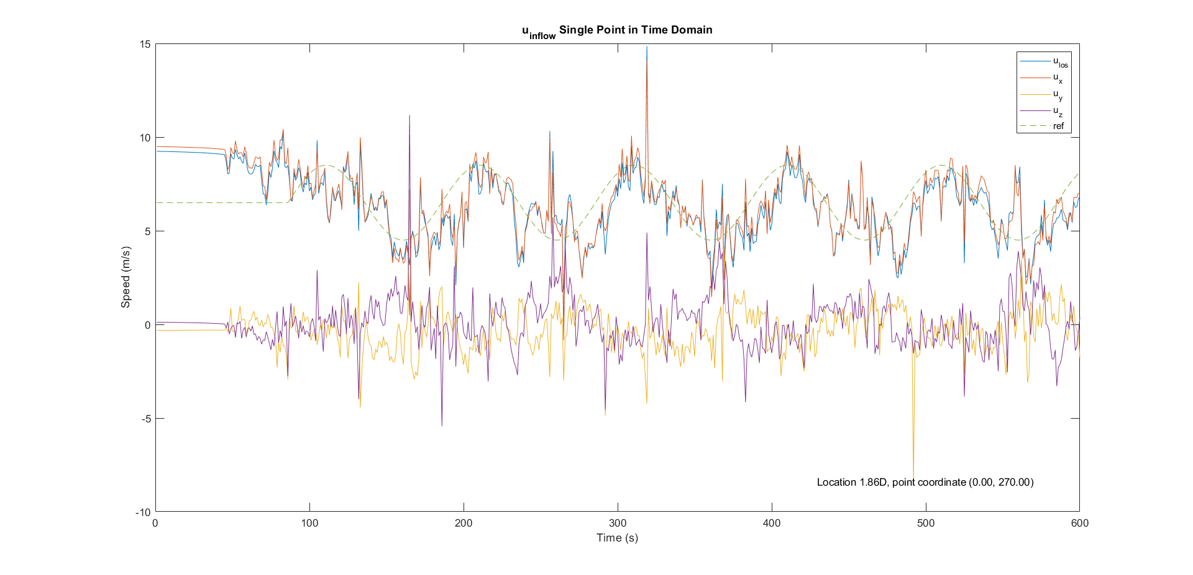
LiDAR --- single point (Turb 8m/s)

Slide 50
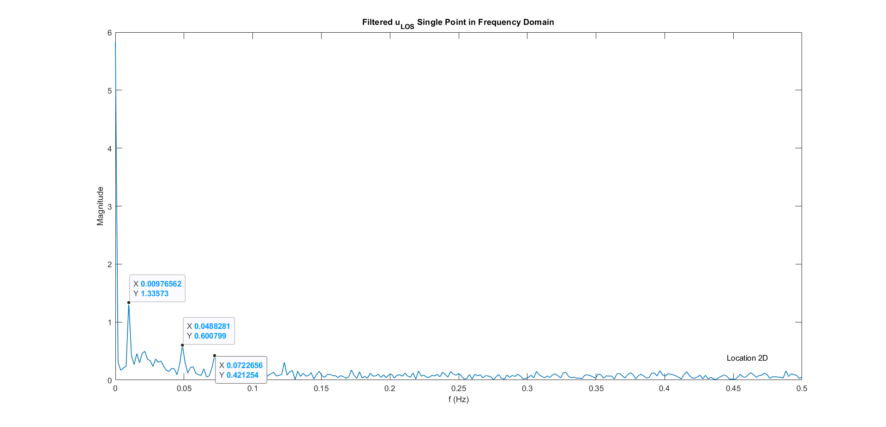
LiDAR --- single point FFT (Turb 8m/s)
Notes:
0.01

Slide 51
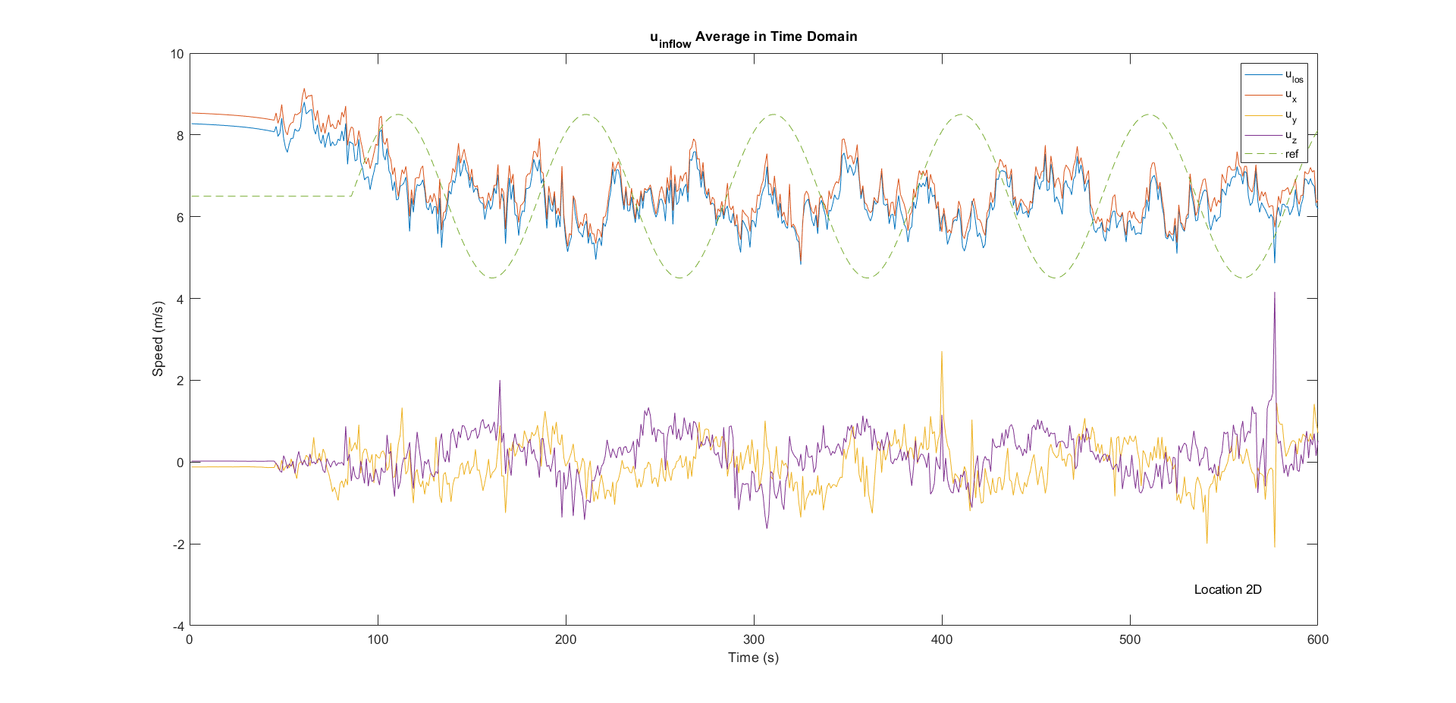
LiDAR --- snapshot (Turb 8m/s)

Slide 52
To-Do
14/06/2024

Slide 53
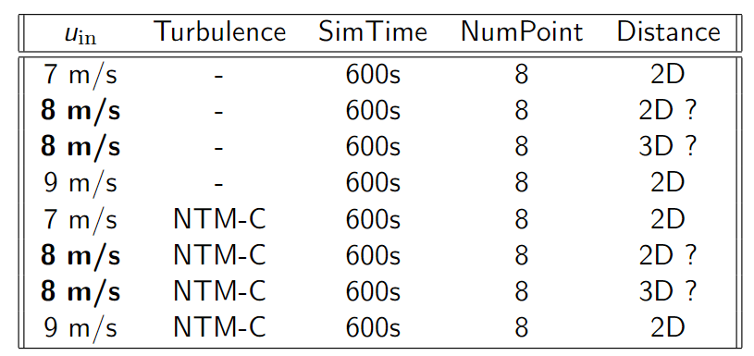
To do
PI Controller: Brutal force reference tracking
Data sampling:
Notes:
Questions:
1. Feature

Slide 54
MoMi and Summer
14/06/2024

